Slide 1
Batch No:12
Supervisor: Dr.Annrose J, M.E., Ph.D.
By,
Dani Priya E (962222205016)
Mary Nirmala A (962222205033)
Medolin Christiyana J (962222205036)
Sherin Rickshiya A (962222205053)

Slide 2
ABSTRACT
Rising security challenges demand intelligent surveillance systems capable of real-time threat detection.
An AI-based surveillance framework is proposed to identify weapons and recognize known criminals from live video streams.
The system leverages YOLOv8 for weapon detection and DeepFace for face recognition, integrated through a web-based monitoring platform.
The approach aims to support faster decision-making and improved public safety in high-risk environments.

Slide 3
OBJECTIVE
To design an AI-based surveillance framework for real-time weapon detection.
To develop a face recognition mechanism for identifying known criminals from video feeds.
To integrate deep learning models with a web-based monitoring interface.
To enhance public safety by enabling early threat identification and alert generation.

Slide 4
DOMAIN DESCRIPTION
The project falls under the Artificial Intelligence and Computer Vision domain.
It utilizes Deep Learning–based object detection for identifying weapons in surveillance footage.
Facial Recognition technology is applied for identifying criminals using biometric features.
The system operates within the Smart Surveillance and Public Safety domain, supporting automated threat monitoring.

Slide 5
LITERATURE REVIEW
S.NO | TITLE | AUTHORS, YEAR & PUBLISHER | ADVANTAGES | DRAWBACKS | METHODOLOGY
1 | Design of an Integrated Model for Video Summarization Using Multimodal Fusion and YOLO for Crime Scene Analysis | S. B. Veesam, A. R. Satish (2025) , IEEE | • Multi-camera analysis • Handles occlusion well | • High computational complexity • Complex system design | • YOLOv8 for weapon detection • Multimodal fusion • Spatio-temporal analysis
2 | Enhancing Public Safety through Real-time Weapon Detection: A Deep Learning Approach | J. M. A. Dass et al. (2024) , ICONAT | • Real-time detection • Lightweight model | • Limited to weapon detection only • No face recognition | • YOLOv7-tiny • CCTV video analysis • Dataset annotation using Roboflow

Slide 6
LITERATURE REVIEW
S.NO | TITLE | AUTHORS, YEAR & PUBLISHER | ADVANTAGES | DRAWBACKS | METHODOLOGY
3 | Hybrid Deep Learning Architecture with K-means Clustering for Weapon Detection in CCTV Surveillance | S. Raj, A. Anant, H. Suryadevara, R. K. Kumar (2024), IEEE | • Reduced model complexity • Improved efficiency | • Uses pre-collected dataset • Weapon detection only | • CNN models (VGG, MobileNet) • K-means clustering • PCA for feature reduction
4 | Smart Video Surveillance Based Weapon Identification Using YOLOv5 | S. Nikkath Bushra et al. (2022), ICESIC | • Faster detection • Works in crowded scenes | • Lower accuracy in extreme lighting • Limited scalability | • YOLOv5 object detection • CCTV-based surveillance • Face recognition support

Slide 7
LITERATURE REVIEW
S.NO | TITLE | AUTHORS, YEAR & PUBLISHER | ADVANTAGES | DRAWBACKS | METHODOLOGY
5 | Effective Deep Learning Technique for Weapon Detection in CCTV Footage | N. Yeddula, B. E. Reddy (2022), IEEE | • High detection performance • Real-time capable | • Focuses only on weapon detection • No criminal identification | • YOLOv5 algorithm • CCTV footage analysis
6 | A Machine Learning and Deep Learning Integrated Model to Detect Criminal Activities | K. F. Arpa et al. (2023), IBDAP | • Multi-module approach • Crime prevention oriented | • Complex system design • High computational cost | • ML + DL integration • Weapon detection • Face recognition

Slide 8
PROBLEM STATEMENT
Manual monitoring of CCTV surveillance systems is inefficient and prone to human error.
Existing systems often fail to detect weapons and identify criminals in real time, especially in crowded or complex environments.
Delayed detection of threats reduces the ability to prevent crimes before they occur.
There is a need for an intelligent surveillance framework that can automatically detect weapons and recognize known offenders from live video feeds.

Slide 9
HARDWARE & SOFTWARE REQUIREMENTS
Hardware Requirements
USB Camera
Computer System (Laptop/Desktop)
Minimum 8 GB RAM
Processor: Intel i5 or higher / Equivalent
Optional: GPU (for faster processing)
Software Requirements
Operating System: Windows / Linux
Programming Language: Python
Deep Learning Framework: PyTorch
Libraries: YOLOv8, DeepFace, OpenCV
Web Framework: Flask
Development Environment: VS Code / Jupyter Notebook

Slide 10
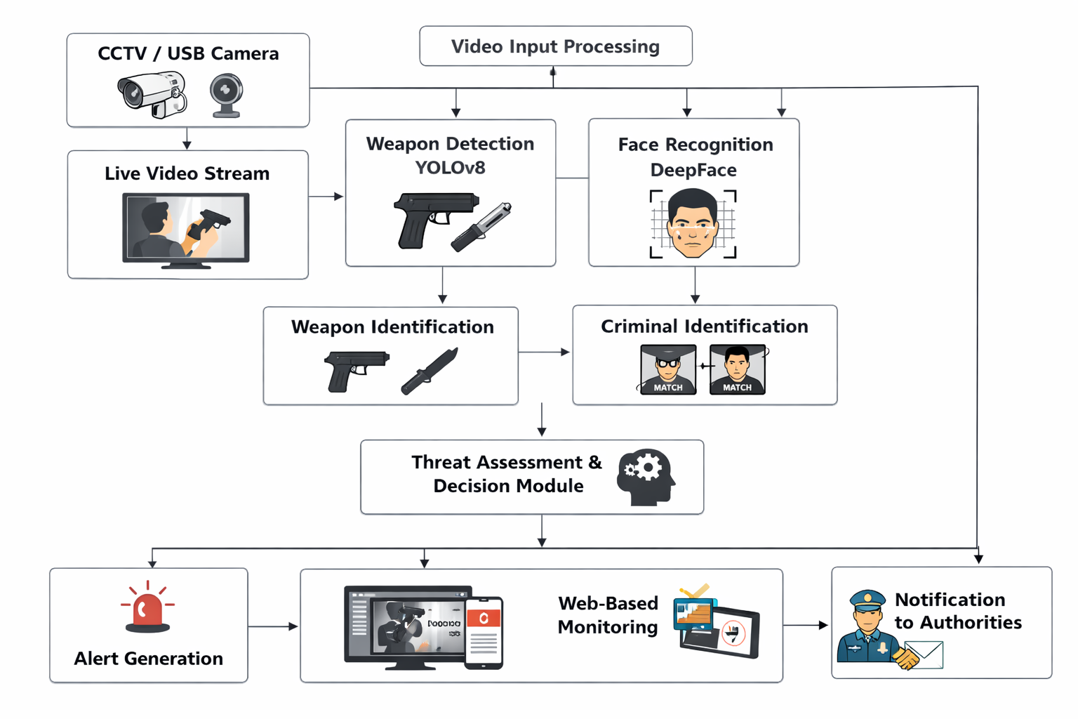
BLOCK DIAGRAM

Slide 11
REFERENCES
[1] S. B. Veesam and A. R. Satish, “Design of an Integrated Model for Video Summarization Using Multimodal Fusion and YOLO for Crime Scene Analysis,” IEEE Access, vol. 13, pp. 25008–25025, 2025, doi: 10.1109/ACCESS.2025.3538282.
[2] J. M. A. Dass, A. Suresh, K. Swathi, P. Shalini, N. A. Y. Sinha, and K. U. K. U, “Enhancing Public Safety through Real-time Weapon Detection: A Deep Learning Approach,” in Proc. 3rd Int. Conf. for Advancement in Technology (ICONAT), Goa, India, 2024, pp. 1–4, doi: 10.1109/ICONAT61936.2024.10775051.
[3] S. Raj, A. Anant, H. Suryadevara, and R. K. Kumar, “Hybrid Deep Learning Architecture with K-means Clustering for Weapon Detection in CCTV Surveillance,” in Proc. IEEE Int. Conf. on Computer Vision and Machine Intelligence (CVMI), Prayagraj, India, 2024, pp. 1–6, doi: 10.1109/CVMI61877.2024.10781588.
[4] S. Nikkath Bushra, G. Shobana, K. Uma Maheswari, and N. Subramanian, “Smart Video Surveillance Based Weapon Identification Using YOLOv5,” in Proc. Int. Conf. on Electronic Systems and Intelligent Computing (ICESIC), Chennai, India, 2022, pp. 351–357, doi: 10.1109/ICESIC53714.2022.9783499.
[5] N. Yeddula and B. E. Reddy, “Effective Deep Learning Technique for Weapon Detection in CCTV Footage,” in Proc. IEEE 2nd Int. Conf. on Mobile Networks and Wireless Communications (ICMNWC), Tumkur, India, 2022, pp. 1–6, doi: 10.1109/ICMNWC56175.2022.10031724.
[6] K. F. Arpa et al., “A Machine Learning and Deep Learning Integrated Model to Detect Criminal Activities,” in Proc. 4th Int. Conf. on Big Data Analytics and Practices (IBDAP), Bangkok, Thailand, 2023, pp. 1–6, doi: 10.1109/IBDAP58581.2023.10272002.

Slide 12
THANK YOU

